Slide 1
Software Reingineering
Credit: Engr. Sehar Gul(Lecture Slides)

Slide 2
Agenda
Course outline
Course related books and material
Marks distribution
Exam pattern
Introduction to course

Slide 3
Course Outline
Introduction
Preparation to Refactor
Refactoring
Re-architecting
The Rewrite

Slide 4
Course Outline
Beyond Refactoring
Automating the Development Environment
Automation Extension to test, staging, and production

Slide 5
Marks distribution
2 Mid Exams | 20 marks | Each
Final Exam | 40 marks | 20 20 rule
Class activity | 5 marks | Activity will be given on a regular basis
Class Tests/Handouts | 10 marks | Best 2 of 3
Class Presentation | 5 marks

Slide 6
Overview of Software Reengineering

Slide 7
Introduction
Developers spend life average at………….
(??)

Slide 8
Introduction
Developers spend life average at………….
Spend much more time on existing than writing new code from scratch
Sometimes with legacy software/projects

Slide 9
Legacy Project
Any existing project that’s difficult to maintain or extend
Project not codebase
Project includes…..(??)

Slide 10
Legacy Project
Any existing project that’s difficult to maintain or extend
Project not codebase
Project includes
Build tools and scripts
Dependencies on other systems
The infrastructure on which the software runs
Project documentation
Methods of communication, such as between developers, or between developers and stakeholders

Slide 11
Characteristics of Legacy Project
Old
Goes with couple of years and maintained by many developers
Large Project
Larger the project, difficult to maintain
Inherited
Written by one developers and maintained by others
Poorly Documented

Slide 12
Exception to above Rules
Linux – (Built in 1991)
Old, large project
What’s the success of Linux till to-date?

Slide 13
Exception to above Rules
Linux – (Built in 1991)
Old, large project
Its culture of open and frank communication.
All incoming changes are thoroughly reviewed, which increases information-sharing between developers

Slide 14
Legacy Code
Untested, untestable Code
Existing code are poorly tested or not tested
Inflexible Code
Add new features - too hard
Code encumbered by technical debt
Not perfect but good enough for now

Slide 15
Legacy Infrastructure
Development Environment
Outdated Dependencies
Java Servlet application (Specific Servlet container, Apache tomcat, …….)
Upgrades provides performance improvements, bug fixes….., But ??

Slide 16
Legacy Infrastructure
Development Environment
Outdated Dependencies
Java Servlet application (Specific Servlet container, Apache tomcat, …….)
Upgrades provides performance improvements, bug fixes…..,
But, Too difficult task to upgrade

Slide 17
Legacy Infrastructure
Development Environment
Outdated Dependencies
Java Servlet application (Specific Servlet container, Apache tomcat, …….)
Heterogeneous Environments
Software goes through different environments through its lifetime

Slide 18
Legacy Culture
Existing Team maintaining software for many years……..
Fear of Change…
Which features are no longer in use…….
Which bugs are safe to fix…..
Consult specific user(s) to change

Slide 19
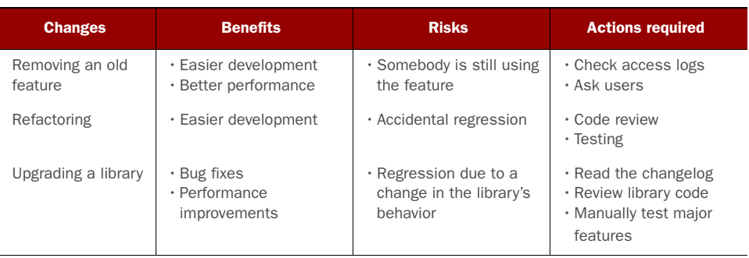
Legacy Culture
Changes, Refactoring and Associated Risks…..

Slide 20
Legacy Culture
Lack of Knowledge
Different Domain
Project-Specific Technical Information
Specific Algorithms
Team Members can help to overcome these but…..

Slide 21
Legacy Culture
Lack of Knowledge
Different Domain
Project-Specific Technical Information
Specific Algorithms
Team Members can help to overcome these but…..
Lack of f2f communication
Code Ego (Don’t want to share code and knowledge)
Busy Face

Slide 22
Software Developers Face
Face different challenges through their career
Deciding where to start for refactoring……

Slide 23
Software Reengineering

Slide 24
Software Reengineering
Reengineering What is it?
Rebuilding a software to create a more powerful product.
Who does it?
-Organizational level: business specialists.
-Software level: Software engineers.
Why it is important?
The rapid change in information technology

Slide 25
Software Reengineering Steps..
Step 1: Business process reengineering. (BPR)
The search for, and the implementation of, radical change in business process to achieve breakthrough results.
Step 2: Software reengineering process
Rebuilding a software to create another with added functionality, better performance and reliability.

Slide 26
BPR Model
A model for business process reengineering defines six activities
Business Definition
Process Identification
Refinement and instantiation
Prototyping
Process Evaluation
Process specification
and design

Slide 27
Software Reengineering Process Model
Software reengineering process model defines six activities
Inventory analysis
Document restructuring
Forward engineering
Reverse engineering
Data restructuring
Code restructuring

Slide 28
Software Reengineering Process Model
Inventory Analysis
Identify active software candidate for reengineering
Document Restructuring
Live with old documentation
Update
Rewrite from scratch

Slide 29
Software Reengineering Process Model
Code Restructuring
Source code is analyzed and violations of structured programming practices are noted and repaired.
Data Restructuring
Update with existing data architecture
Forward Engineering
Recovers design information from existing source code and uses this information to reconstitute the existing system to improve its overall quality and/or performance

Slide 30
Thank You

